Slide 1

Department of Information Technology
NBA Accredited A.P. Shah Institute of Technology G.B.Road,Kasarvadavli, Thane(W), Mumbai-400615 UNIVERSITY OF MUMBAI Academic Year 2021-2022

Slide 2
A Project Presentation on Automatic Number Plate Detection Submitted in partial fulfilment of the degree of Bachelor of Engineering (Sem - 6) in
INFORMATION TECHNOLOGY By Keval Gada(20204002)
Aadarsh Khant(20204003)
Tanay Jain(20204004)
Under the Guidance of Prof. Manjusha Kashilkar

Slide 3
1.Project Conception and Initiation

Slide 4
1.1 Objectives
To make an application that will be detecting number plate & helmet from moving vehicles.
To eliminate human work time by adding this system into traffic management sector.

Slide 5
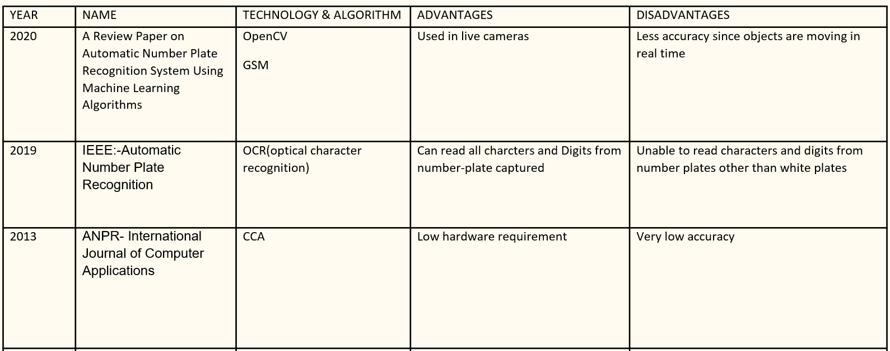
1.2 Literature Review

Slide 6
1.3 Problem Definition
Nowadays, all around the world there are major accidents taking place due to which people are losing their lives. Not wearing helmet is one of the major causes of death. The death rate can be decreased if people start wearing helmets.
So, penalizing the people not wearing helmet will make people wear helmets causing decrease in death rate and ensuring their safety.
It is difficult for humans to start penalizing every person without helmet. So, there is a need of system that detects a license plate from a two-wheeler so that the person without helmet can be penalized.

Slide 7
1.4 Scope
This system can be implemented in real time.
It can be very helpful in the traffic management system as it is minimizing the workload of a authority in-charge.
This system can be placed on traffic-signals for effective use so it can capture the whole area of a road.

Slide 8
1.5 Technology stack
OpenCV
Numpy
Imutils
YoloV3
CNN

Slide 9
2. Project Design

Slide 10
2.1 Proposed System
This project aims to recognize number plates from moving vehicles.
After detecting the number plate, it will detect whether the rider is wearing a helmet or not.

Slide 11
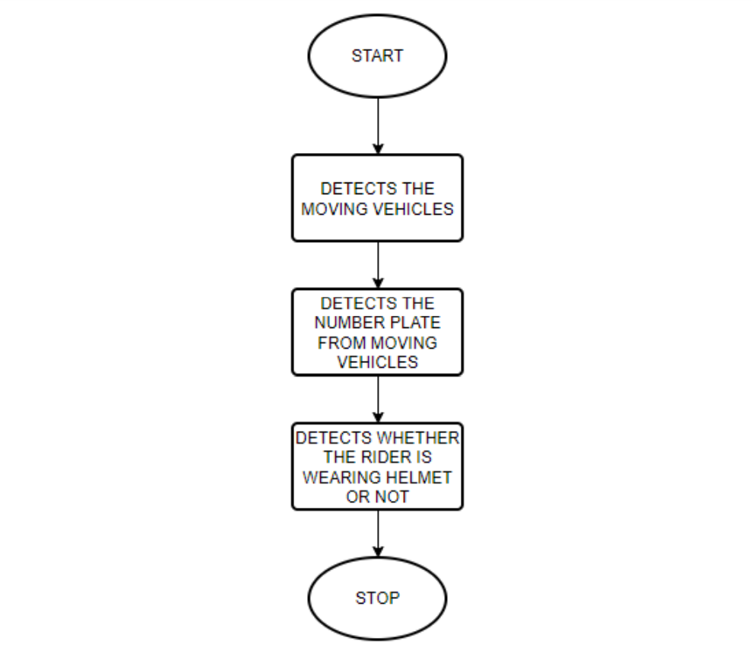
2.2 Design(Application Work flow)

Slide 12
3. Implementation

Slide 13
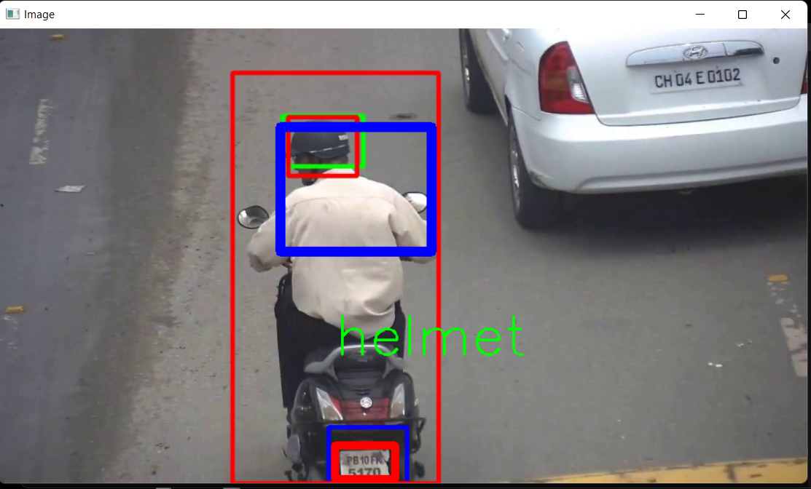
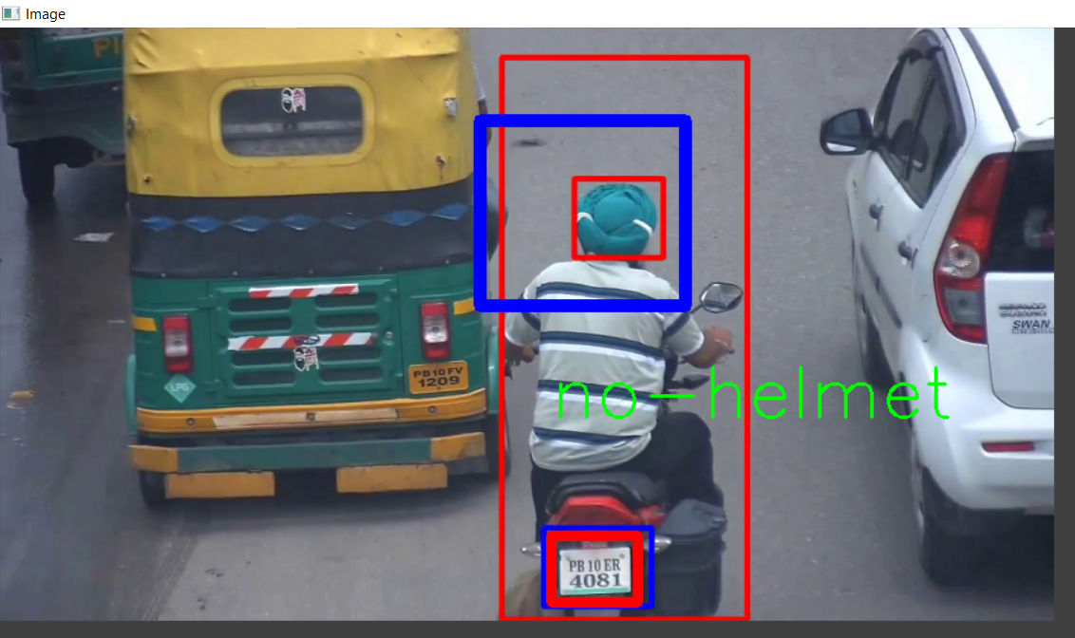
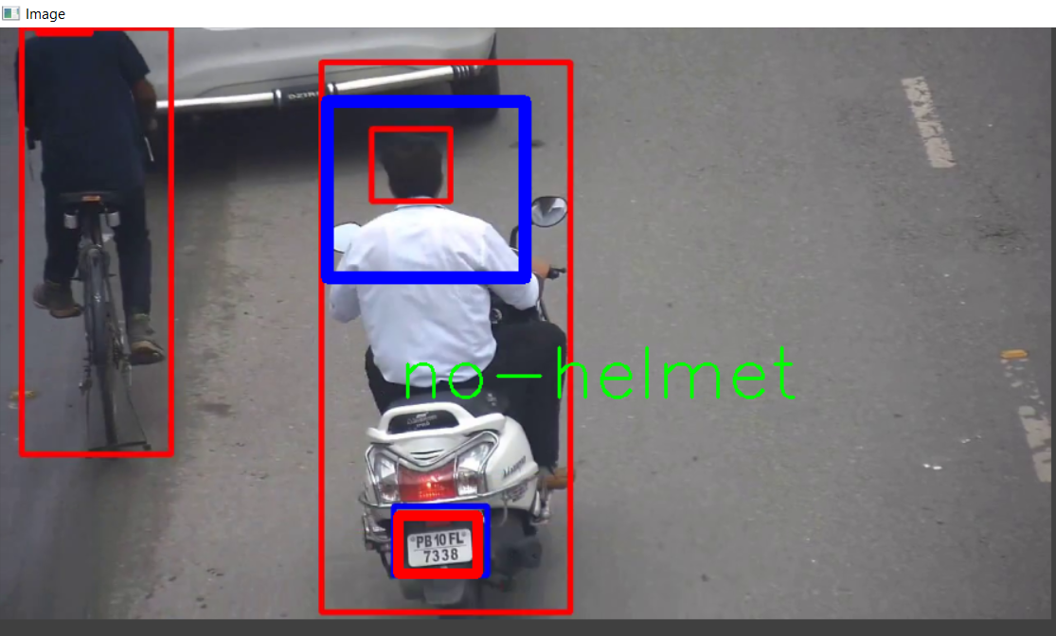
3. Implementation

Slide 14
4. Result

Slide 15
4. Project Outcomes
System is able to detect moving vehicle on the road.
System is able to detect number plate from the moving vehicles.
System is able to detect whether the rider is wearing a helmet or not.

Slide 16
5. Conclusion and Future Scope

Slide 17
5.1 Conclusion
In this project, we have developed an application to detect number plate and helmet from a moving vehicle.
From the above results, we can conclude that number plate recognition and helmet detection will perform better as the quality of the camera used for scanning the plate and detecting the vehicles and helmet will be excellent.
Using low quality camera will degrade the performance and may misclassify the result.

Slide 18
5.2 Future Scope
Can be connected to cctv cameras to work in real time.
Can be combined with database system to keep track of vehicles.

Slide 19
References
Shraddha S. Ghadage , Sagar R. Khedkar Volume 08, Issue 12 (December 2019) PAPER ID: IJERTV8IS120398
https://stackoverflow.com
https://www.geeksforgeeks.org
https://www.w3schools.com

Slide 20
Thank You

